Slide 1

Stennis
Propulsion Center
April 26, 2023
John Masaveg
Deputy Director

Slide 2
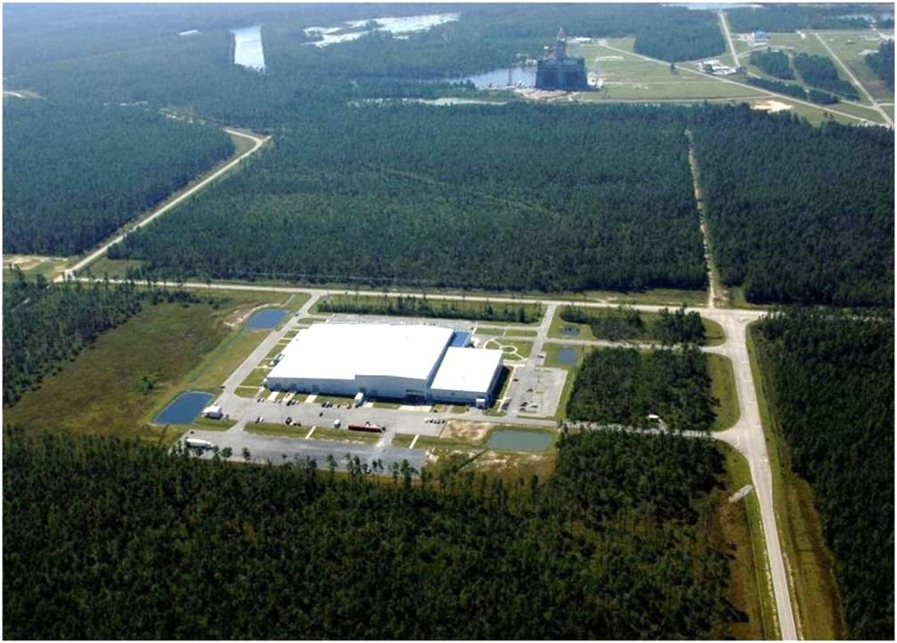
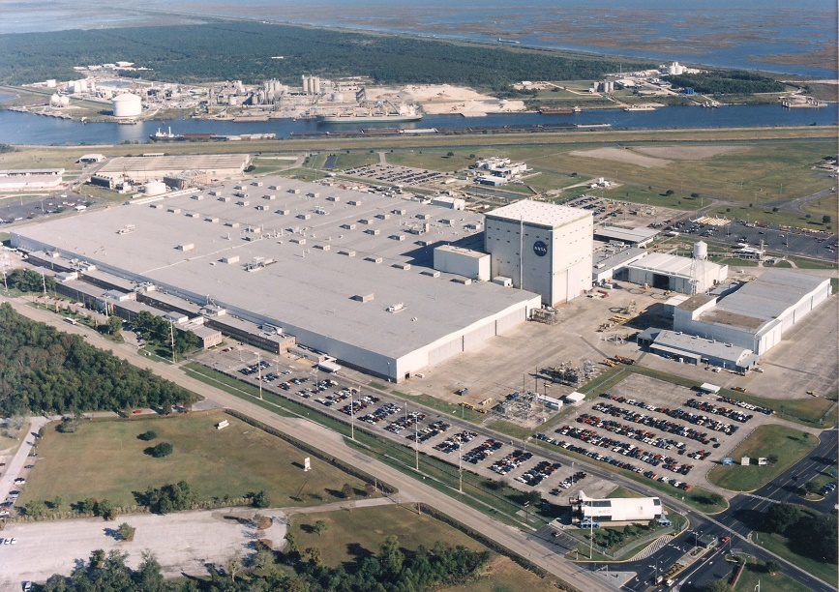
PMAC - Charter
  Our Mission is to partner with the enterprise/internal manufacturing centers to develop new capabilities and deliver high class quality products to our customers and warfighters.
Stennis
Michoud

Slide 3
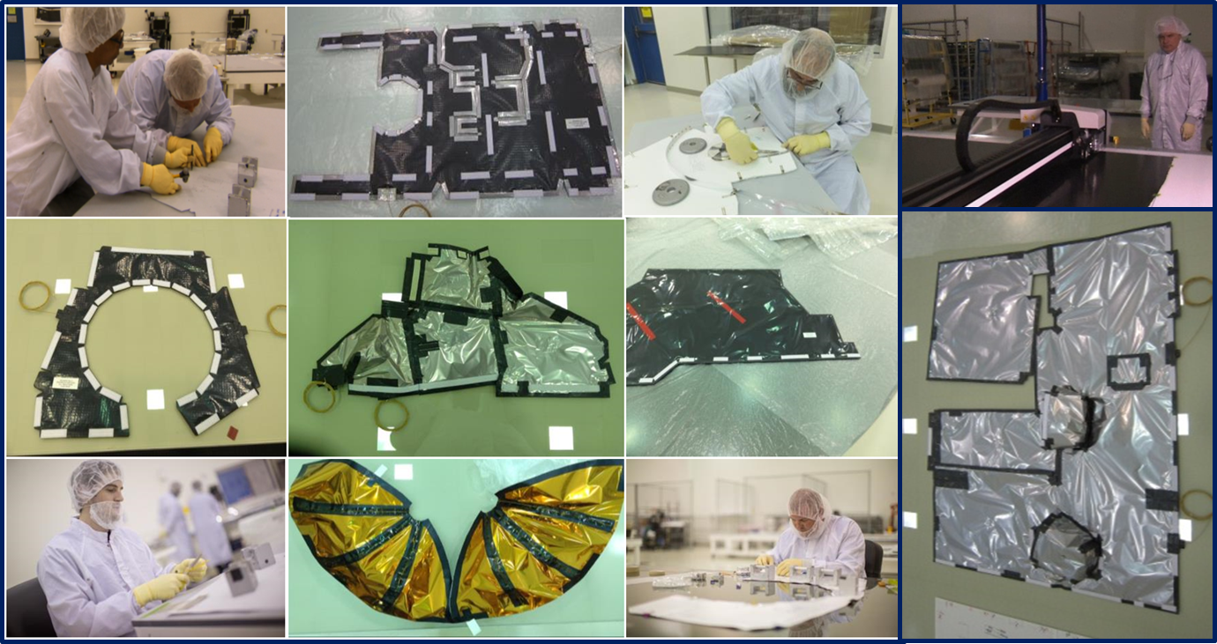
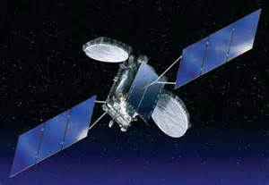
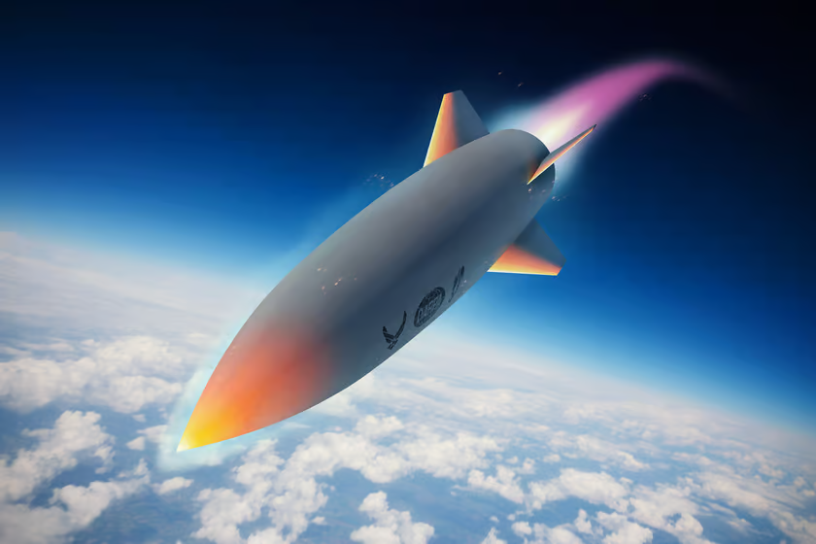
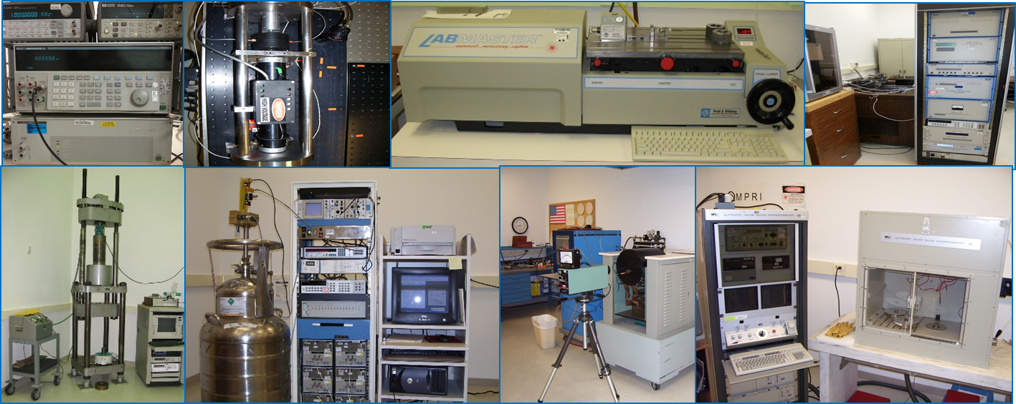
PMAC – What We Do
SSC - Propulsion Manufacturing Center
  Manufacture and Test of Propulsion Sub-Systems for Satellites, Missiles & Human Rated Spacecraft
  Fabricate/Install Multi-Layer Insulation on Satellites, Missiles, propulsion systems & satellites
  Fabricate/Qualify Thermal Protection Heat Pipes for Satellites and Spacecraft
Metrology Laboratory
  Space & Ground Solution Capabilities
Propulsion Sub-Systems
Multi-Layer Insulation
Hypersonic Missile
Inflatable Habitats
Metrology Laboratory

Slide 4
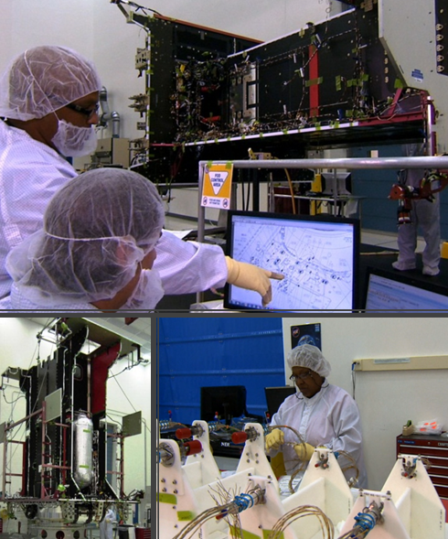
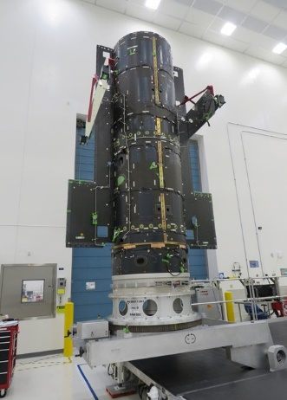
PMAC - Capabilities
Capacity
  14 Satellite Propulsion Sub-Systems/Year
  3500+ Detailed Parts & Assemblies/Year
  2500+ Thermal Blankets/Year
Production Capabilities
  53,000 ft² High Bay Clean Rooms - Class 6, 7 & 8
  Automated Tube Bending and Inspection
  Aqueous Flow and Ultrasonic Precision Cleaning
  Automated Thermal Blanket Projection and Cutting
  Etch/Chem Line (Coming Q3 of 23)
  Machining Center
Test Capability
  Large Structure X-Ray Inspection
  High Pressure Test Facility
  System level testing/check-out

Slide 5
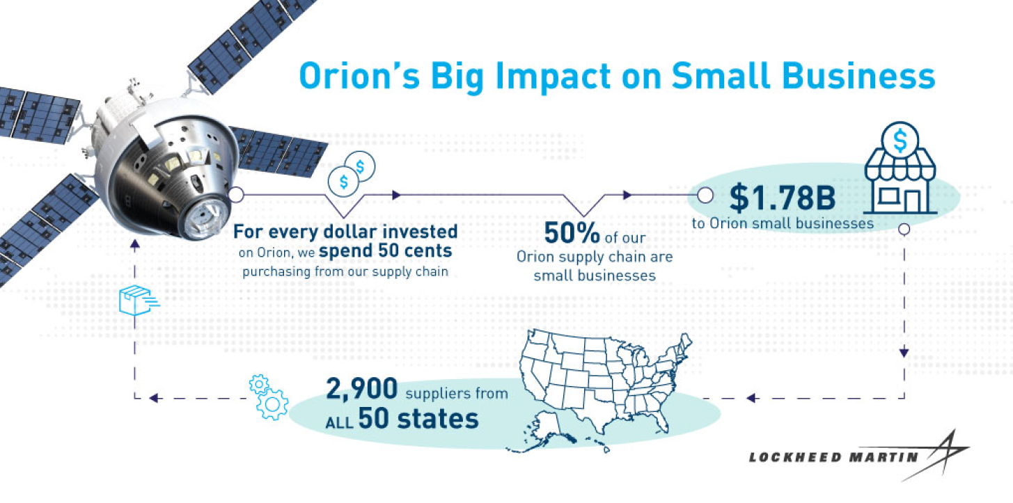
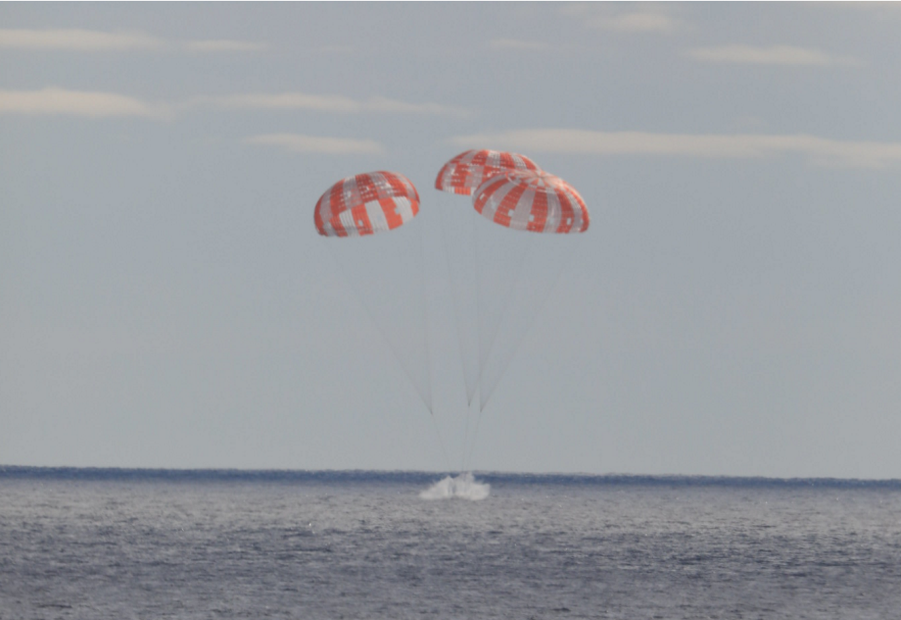
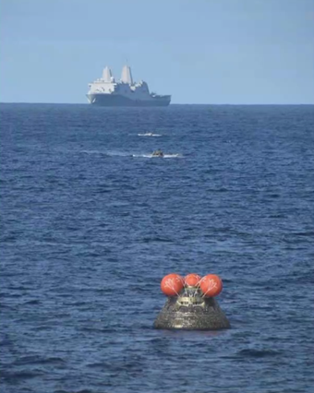
Economic Impact
Orion’s Overall Impact
LM’s local Impact
Re-positioning Work
Working with program and center leaders to seek opportunity to shift work to our centers.
Currently partnering with the following community colleges:
Nunez Community College
Peal River Community College
Gulf Coast Community College
Northshore Community College
~Total Jobs
  MAF – 216 EQ
  PMC – 120 EQ
Sourcing New Work
Community Outreach
Increasing Headcount

Slide 6
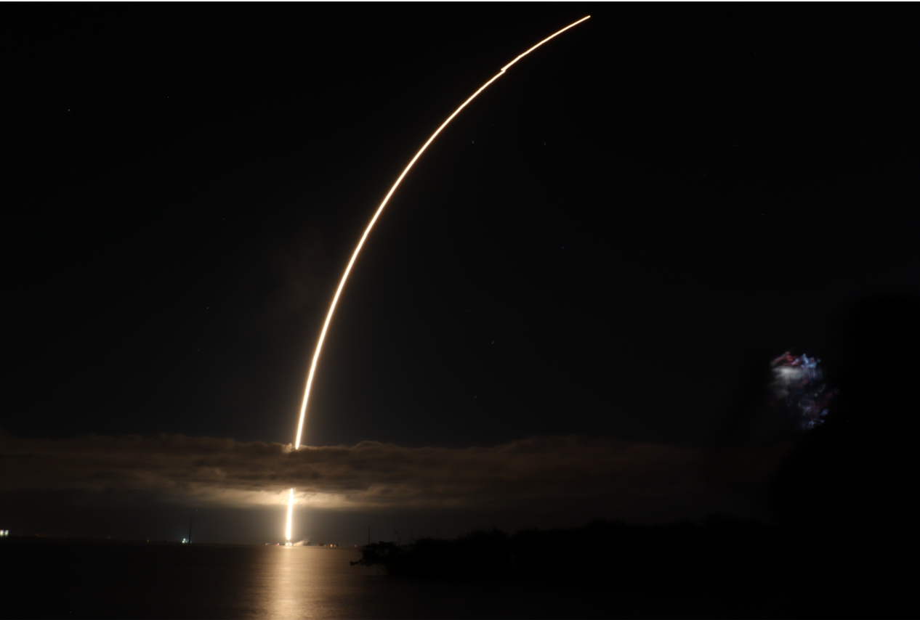
PMAC – Small Business Needs
SSC - Propulsion Manufacturing Center
  Fabrication Shops
    Machining
    Coatings
    Welding
  Talent Acquisition/Development
Metrology Laboratory
  None at the moment

Slide 7
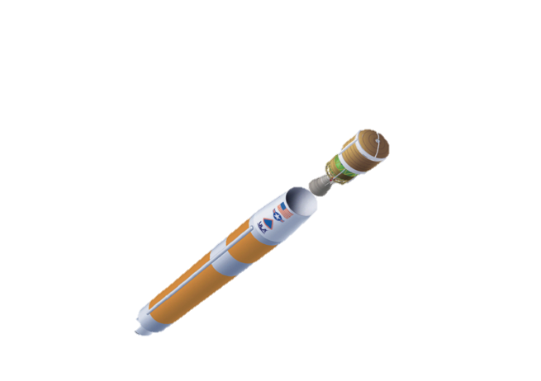
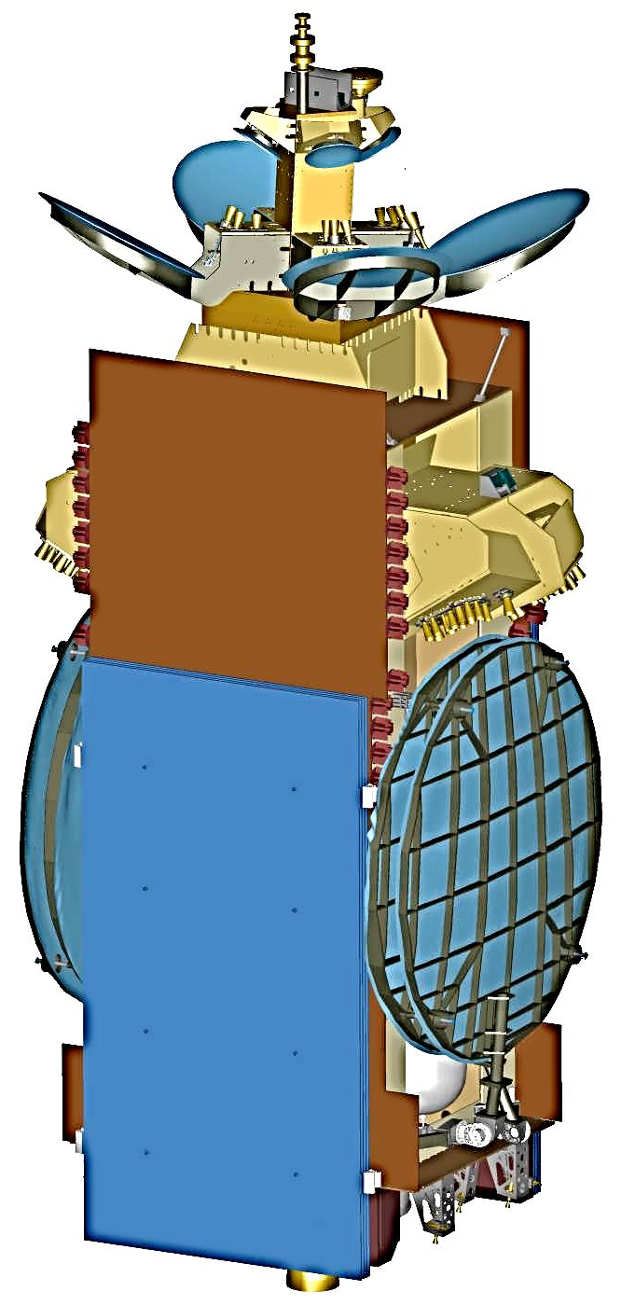

Supplier Registration
Supplier Registration
Suppliers need to register within the third party platform (Exostar) to access RFx and PO’s from LM
  Link Below for registration/FAQ’s
MyExostar - MyExostar is a knowledgebase for all your training needs!
LM Contact info: John Masaveg – (504)206-8774

