Slide 1
NASA Shared Services Center (NSSC)
Stennis Space Center (SSC)
Information Technology Procurement Office (ITPO)
Troy E. Miller
Small Business Specialist
April 29, 2026

Slide 2
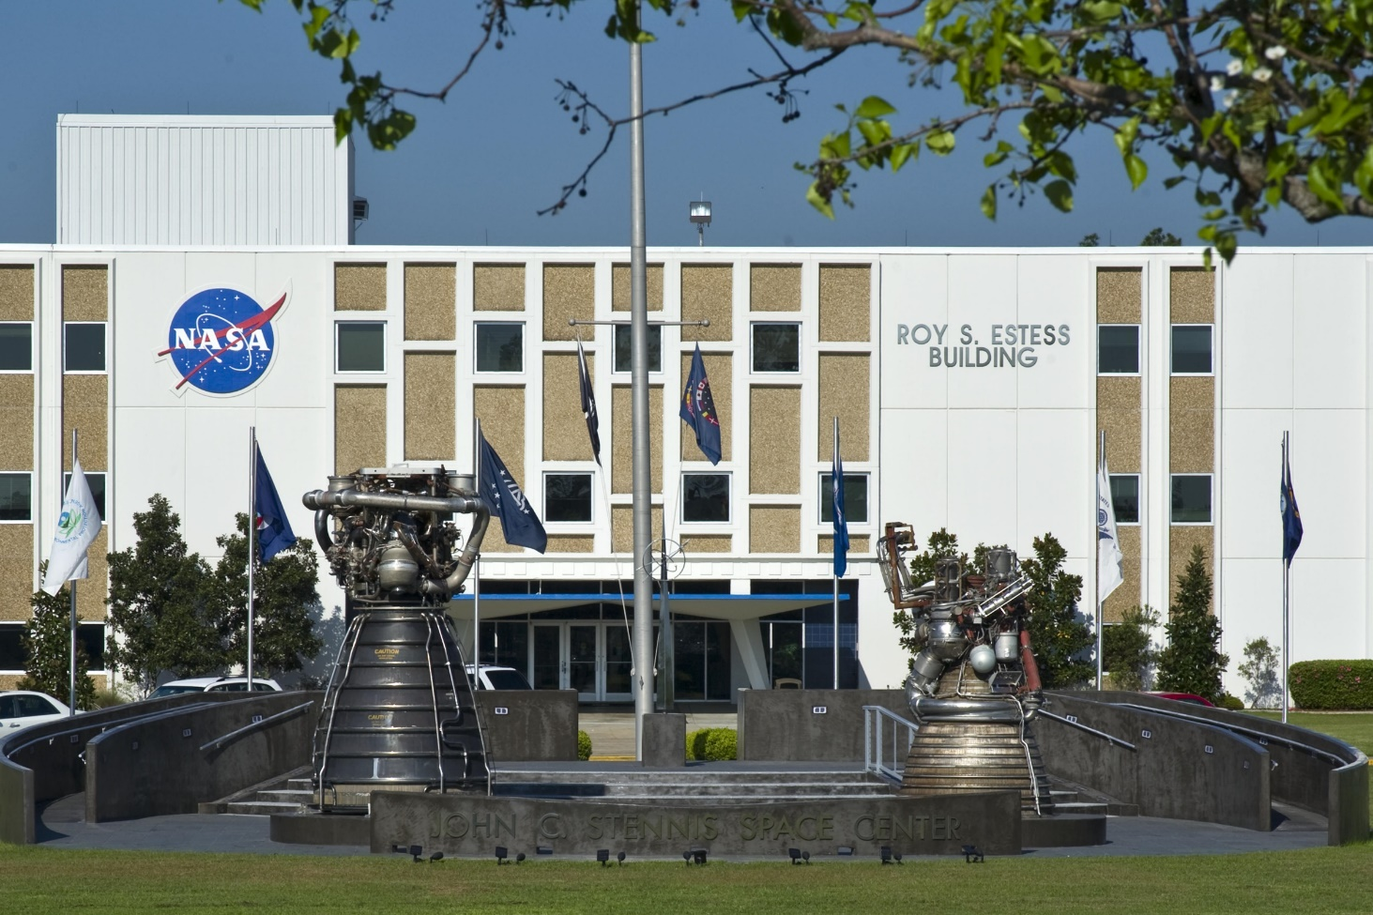
SSC Federal City
https://www.nasa.gov/stennis/about-stennis/employers-and-careers/
Department of Commerce
National Data Buoy Center
National Marine Fisheries Service
National Centers for Environmental Information
State of Louisiana
Louisiana Technology Transfer Office
State of Mississippi
Center of Higher Learning
Mississippi Enterprise for Technology (MSET)
Northern Gulf Institute – Mississippi Science and Technology Center
School of Ocean Science and Engineering – University of Southern Mississippi
Department of Defense
Commander, Naval Meteorology and Oceanography Command
Naval Oceanography Operations Command
Naval Research Laboratory Detachment
Navy Office of Civilian Human Resources
Special Boat Team TWENTY-TWO
NAVSCIATTS
Contractors
Aerojet Rocketdyne, Inc.
ALUTIIQ Essential Services, LLC
S3 (Syncom Space Services)
SaiTech, Inc.
Pacific Architects & Engineers, Inc. (PAE)
General Dynamics Information Technology
Chenega Global Protection, LLC
Lockheed Martin Mississippi Space and Technology Center
Leidos, Inc.
Bastion Technologies, Inc.
CBF Partners JV, LLC
MDW Associates
Rolls Royce North America
Relativity Space
Department of Energy
Department of Energy
Department of Interior
Hydrologic Instrumentation Facility – U.S. Geological Survey
Government Publishing Office
Government Publishing Office
National Aeronautics and Space Administration
John C. Stennis Space Center
NASA Shared Services Center
National Center for Critical Information Processing and Storage
Department of Homeland Security
Immigration Customs Enforcement
2

Slide 3
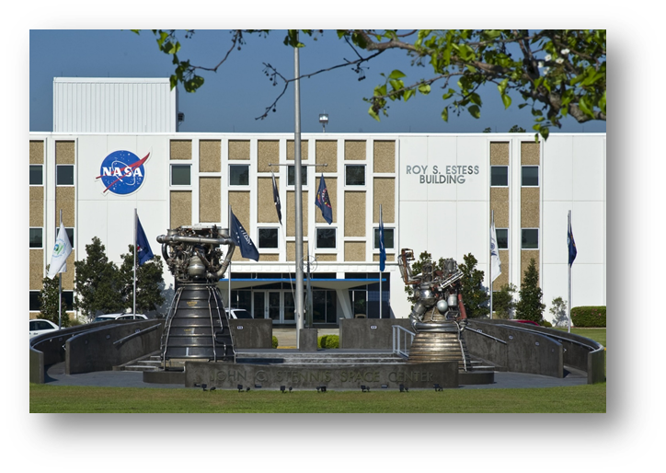
STENNIS SPACE CENTER
Rocket Propulsion Testing Ground
Heavy Lift and Propulsion Technology
Commercial Crew Development
Facility Operation Support Services
Construction Services (Southern Region)
Protective Services
Laboratory Services
Test Operation Services
SSC Small Business Video
https://www.youtube.com/watch?v=kOp9pi7GZic
Stennis Space Center Virtual Tour https://www.youtube.com/watch?v=VOPJHGBu8KY
https://www.youtube.com/@NASAStennis/featured

Slide 4
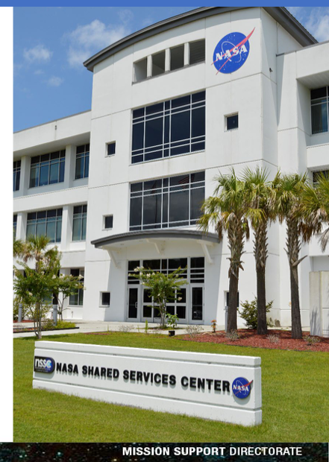
NASA Shared Services Center (NSSC)
NSSC PORTFOLIO OF SERVICES
  Procurement Services (Simplified Acquisitions, SBIRs, & Grants
  Financial Management Services
  Human Resources Services
  Enterprise Services
  Agency Business Support Services
  Agency Ground Maintenance & Custodial Services
  NASA Enterprise-wide Human Capital Support Services
  Located at Stennis Space Center but is a separate entity

Slide 5
NASA Shared Services Center (NSSC)
NSSC NEW POTENTIAL PORTFOLIO OF SERVICES
Current Agency-wide contracts transferring to the NSSC
  NASA Logistics Support Services – Various stand-alone contractor holders. Establishing an Enterprise-wide BPA for all centers to order services,
  NASA Environment Support Services Contract (NESS) valued at $225.0M (9 Awardees, 2LB & 7 SB). The environmental contract provides services such as compliance, hazardous waste management, and pollution prevention across NASA facilities.

Slide 6
Information Technology Procurement Office (ITPO)
The NASA IT Procurement Office is a virtual office that works in close partnership with NASA’s Office of Chief Information Officer in developing strategic approaches to acquiring and delivering NASA’s IT needs. The portfolio is composed of three primary areas:
1) Enterprise IT Contracts cover End-User IT Services, Cybersecurity, Communications, Software, and Application services over $350K.
The Center IT contracts cover a wide breadth of Center-unique IT services.
Solutions for Enterprise-Wide Procurement (SEWP) Program. SEWP is a government-wide Acquisition Contract (GWAC) consisting of over 140 pre-competed Prime Contract Holders that provide a variety of IT products and services to all federal agencies.
ITPO Contractor Steering Council (CSC) that meets monthly.
“Small Business Spotlight” Seeking Small Businesses to present monthly (10 minutes)
This is a great opportunity to provide information about your capabilities.
Small Businesses that provide IT services can use the following survey to submit interest in presenting: ITPO.CSC.info@gmail.com
Communication with ITPO
ITPO CSC email – ITPO.CSC.info@gmail.com
LinkedIn page – ‘ITPO Contractor Steering Council (CSC)’

Slide 7
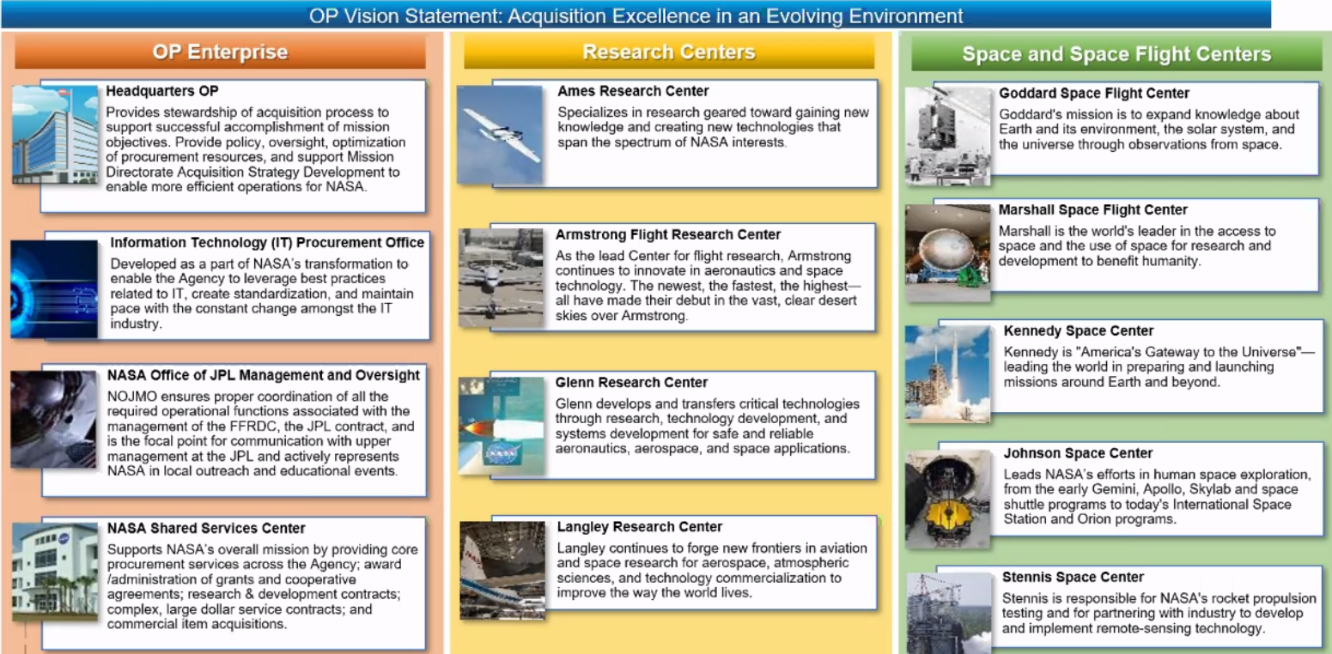
Enables the Agency’s mission and execute contracts in support
of programmatic, institutional, and operational needs

Slide 8
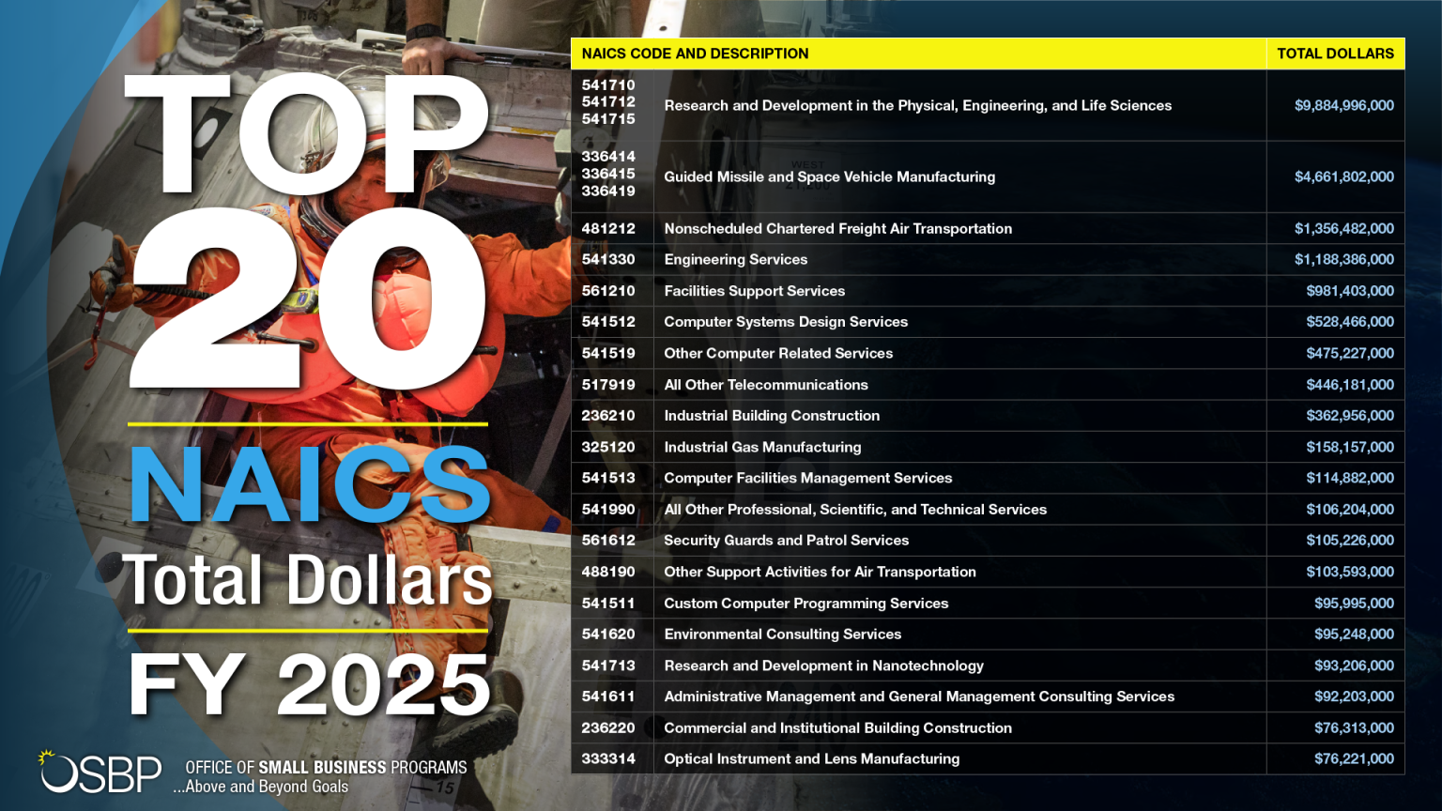
NASA FY25 Top 20 NAICS

Slide 9
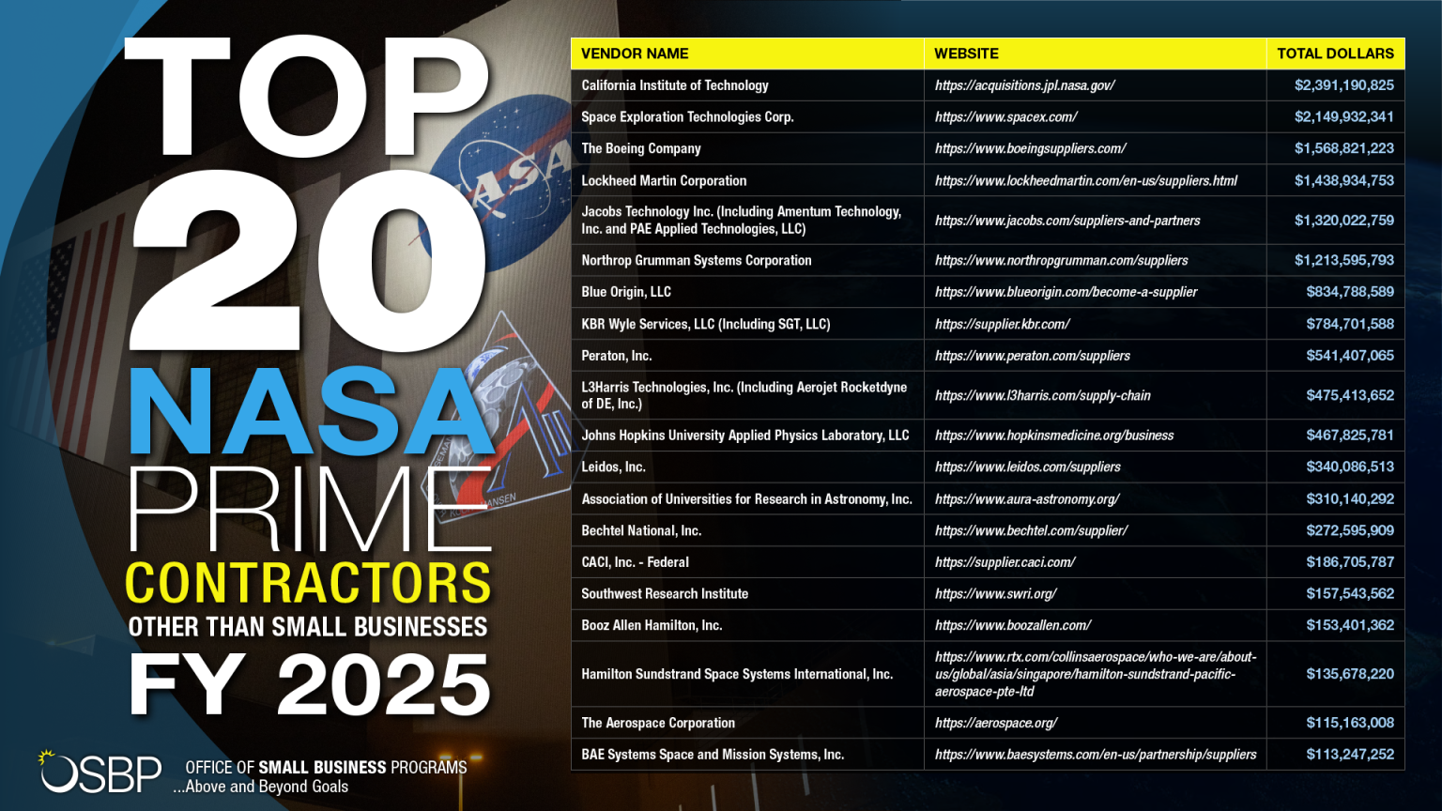
NASA FY25 Top Vendors

Slide 10
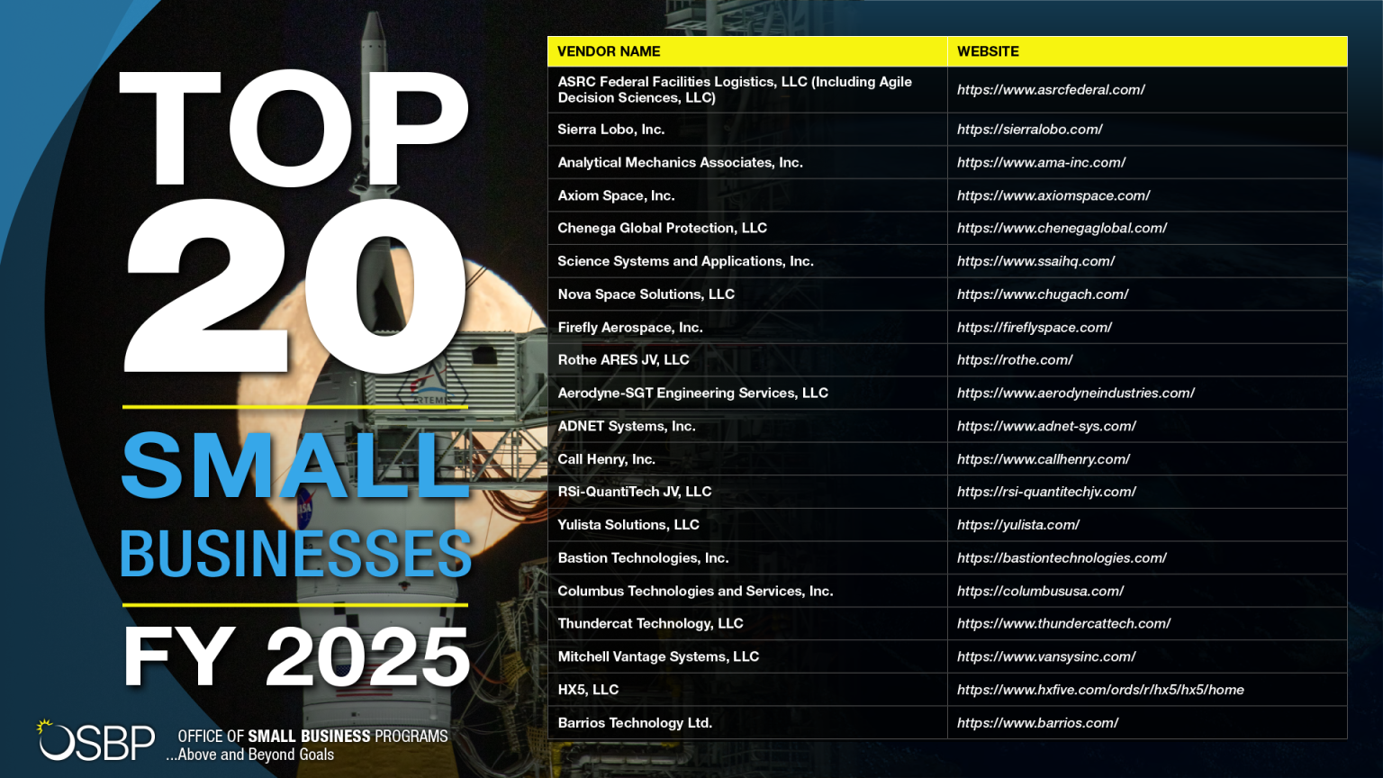
NASA FY25 Top 20 Small Businesses

Slide 11
NSSC & SSC List of Major NAICS Codes
221122 - Electric Power Distribution
334111 - Electronic Computer Manufacturing
334516 - Analytical Laboratory Instrument Manufacturing
513210 - Software Publishers
541511 - Custom Computers Programming Services
541519 - Other Computer-Related Services
541713 - Research and Technology in Nanotechnology
541715 - Research and Development in the Physical, Engineering, and Life Sciences (Except Nanotechonology & Biotechnology)
541611 - Office Administrative Services
561210 - Facilities Support Services
561612 - Security Guards and Patrol Services
611430 - Professional and Management Development Training

Slide 12
ITPO List of Major NAICS Codes
541512 – Computer Systems Design Services
518210 – Computing Infrastructure Providers, Data Processing, Web Hosting, and Related Services
541519 – Other Computer-Related Services
541513 – Computer Facilities Management Services
541330 – Engineering Services
334111 – Electronic Computer Manufacturing
334513 – Instruments and Related Products Manufacturing for Measuring, Displaying, and Controlling Industrial Process Variables
334516 – Analytical Laboratory Instrument Manufacturing
334220 – Radio and Television Broadcasting and Wireless Communications Equipment Manufacturing

Slide 13
Doorways To The NASA Marketplace
HQ Office of Small Business Program (OSBP):
https://www.nasa.gov/osbp
  Acquisition forecast
  Active Contracts Listing (ACLs)
  NASA Major Prime contractors
  OSBP Small Business Specialist
  NASA Outreach Events
  NASA Centers information and major procurement NAICS
  Mentor Protégé information
  www.nasa.gov/nssc ---- NSSC/ SSC Marketing Guide

Slide 14
Doorways To The NASA Marketplace, cont’d
What Can Small Businesses Do?
1) Review the NASA Acquisition Forecast and Active Contract Listings (ACLs) for opportunities.
2) Once an opportunity is identified contact FOIA Officer at that center to request a copy of the SOW or search sam.gov archives.
3) Review the SOW to ensure your capabilities match the requirements.
4) Determine if you will bid solo or team with the incumbent or other company.
5) Contact the SBS in regards to the incumbent POC information for an introduction.
6) Attend NASA outreach events for network/ matchmaking opportunities with other NASA prime contractors.

Slide 15

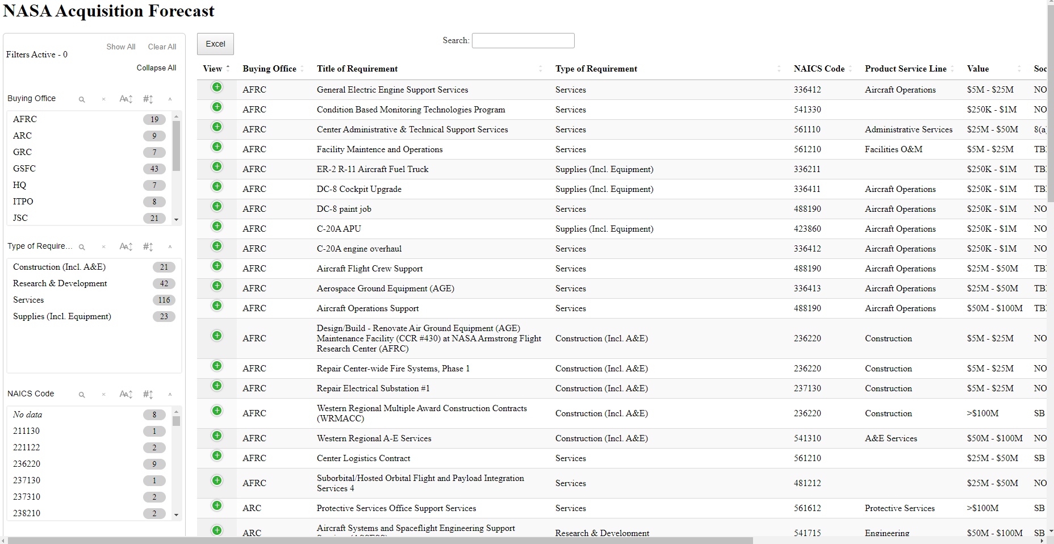
NASA Acquisition Forecast

Slide 16
Procurement Opportunities
Simplified Acquisition Threshold (SAT)
  Threshold increased October 1, 2025 from $10K - $250K to $15K - $350K
  Posted on sam.gov for 5-7 days as SB set aside for market research
  No SB response go to full and open competition
  Quick procurement process (30 days)
  Do not have an acquisition forecast
  Enterprise Software Procurements (ESP)
  Division with the IT Procurement Office that purchases all agency software procurements over SAT. Opportunities are posted on sam.gov, GSA, and Solution for Enterprise-Wide Procurements (SEWP).

Slide 17

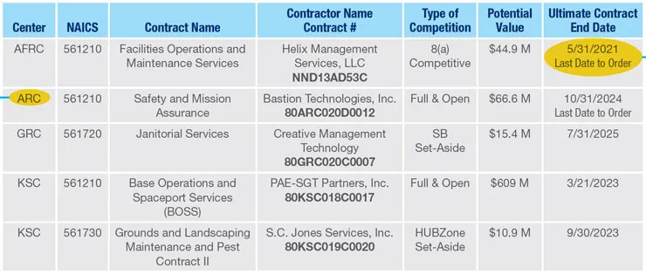
Active Contract Listings
Recurring contracts / Long-term planning purposes
ACLs are grouped based on NAICS codes and are categorized as follows:
Accounting Financial Business Services
Administrative Services
Environmental Services and Remediation
Facilities Maintenance Services
Information Technology Services
Multiple Award Construction
Occupational Health
Protective Services

Slide 18
NSSC/ SSC Upcoming Opportunities
Requirement (Description/NAICS Code) – | NAICS | POP, including options (e.g., number of years or months) | Est. Total Value, including options | Competition | Estimated Award Date (FY/QTR) | Current Status
Enterprise Custodial, Landscaping, & Pest Control Services (ECLPS) formerly Ground Maintenance | 561210 | TBD | $800.0M | Full & Open (Multiple Awards) (LB & SB) | TBD | Pre-solicitation documentation being developed.
NASA Enterprise Wide Human Capital Support Services (NEHCSS) | 541612 | 2/1/23 – 8/31/28 | $88.0M | WOSB Set Aside (Multiple Awards) | TBD | Market Research RFI being developed.
Equal Opportunity Support Services (EOSS) | 541611 | 9/1/23 – 8/31/2028 | $2.0M | SB Set Aside (Multiple Awards) GSA MAS | TBD | Market Research RFI being developed.
Sign Language & Interpreting Services | 541390 | 9/1/22 -8/31/27 | $8.5M | 8(a) Set Aside GSA MAS | TBD | Market Research RFI being developed.
National Center for Critical Information Processing and Storage (NCCIPS) | 541513 | 8/1/19 – 9/30/27 | $180.0M | Full & Open | TBD | Pre-solicitation documentation being developed.
Early-Stage Innovations & Partnership Services (ESIP) | 541611 | 2/2/23 – 2/1/28 | $47.5M | Full & Open Multiple Awards (LB & SB) | TBD | Market Research RFI being developed.
Contract Audit Support Services (CASS) | 541211 | 10/21/21 – 4/20/27 | $55.0M | SB Set Aside (Multiple Awards) GSA MAS | TBD | Market Research RFI being developed.
NASA Logistics Support Services (NLSS) | 561210 | TBD | $800.0M | Full & Open (Multiple Awards) (LB & SB) | TBD | Market Research RFI being developed.
Multiple Award Construction Contracts (MACC III) | 236210 | 10/24/17 -10/23/27 | $2.0B | Full & Open (Multiple Awards) (LB & SB) | TBD | Market Research RFI being developed.
ISO 9001 Audit Services | 541611 | 10/1/24 -13/31/28 | $1.0M | Full & Open | TBD | Market Research RFI being developed.

Slide 19
NASA Mentor Protégé Program (MPP)
Mentor Eligibility
A mentor must be a NASA prime contractor with a current NASA contract that includes a small business subcontracting plan. Prospective mentors must be approved by the NASA Office of Small Business Programs (OSBP) to participate as mentors, and the required mentor application may be submitted prior to or in conjunction with a proposed MPP agreement.
Protégé Eligibility
Eligible protégés include:
Small businesses (including small businesses within any of the small business socioeconomic programs);
Historically black colleges or universities;
Minority-serving institutions;
Nonprofit organizations participating in the AbilityOne Program.
Prospective protégés must be approved by the NASA OSBP to participate a protégé, and the required protégé application must be submitted in conjunction with a proposed MPP agreement, which includes identifying a mentor
Mentors and protégés are responsible for identifying a counterpart for participation and NASA does not establish these partnerships.

Slide 20
ELIGIBLE NAICS CODES
CODE | DESCRIPTION
325120 | INDUSTRIAL GAS MANUFACTURING
333314 | OPTICAL INSTRUMENT AND LENS MANUFACTURING
334511 | SEARCH, DETECTION, NAVIGATION, GUIDANCE, AERONAUTICAL, AND NAUTICAL SYSTEMS, AND INSTRUMENT MANUFACTURING
336414 | GUIDED MISSILE AND SPACE VEHICLE MANUFACTURING
336415 | GUIDED MISSILE AND SPACE VEHICLE PROPULSION UNIT AND PROPULSION UNIT PARTS MANUFACTURING
336419 | OTHER GUIDED MISSILE AND SPACE VEHICLE PARTS AND AUXILIARY EQUIPMENT MANUFACTURING
481212 | NONSCHEDULED CHARTERED FREIGHT AIR TRANSPORTATION
488190 | OTHER SUPPORT ACTIVITIES FOR AIR TRANSPORTATION
517919 | ALL OTHER TELECOMMUNICATIONS
541330 | ENGINEERING SERVICES
541512 | COMPUTER SYSTEMS DESIGN SERVICES
541519 | OTHER COMPUTER RELATED SERVICES
541715 | RESEARCH AND DEVELOPMENT IN THE PHYSICAL, ENGINEERING, AND LIFE SCIENCES - EXCEPT NANOTECHNOLOGY AND BIOTECHNOLOGY
*NASA OSBP may consider contracts with other NAICS codes on a case-by-case basis.

Slide 21
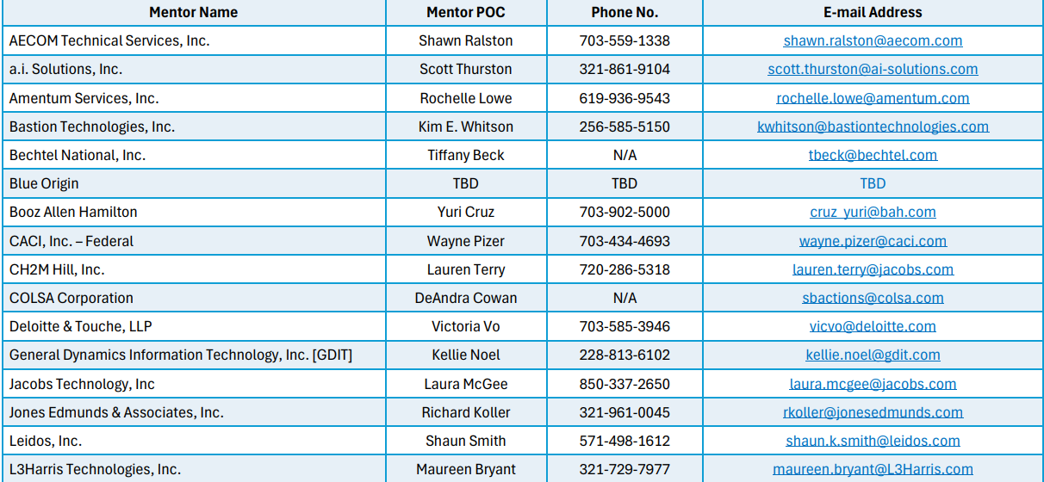
NASA APPROVED MENTORS – STATUS

Slide 22
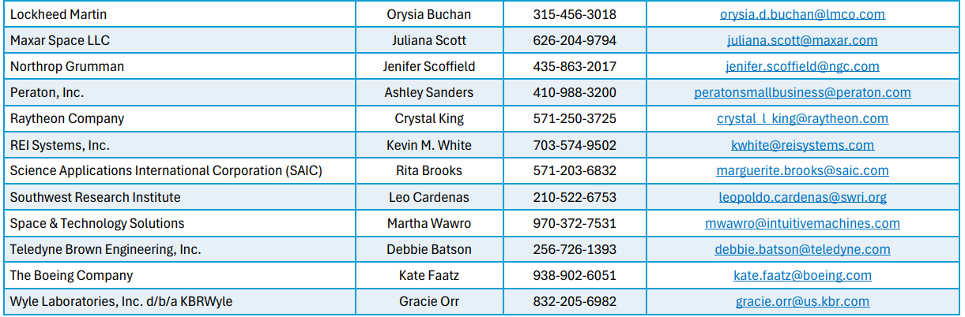
NASA APPROVED MENTORS – STATUS (cont.)

Slide 23
NASA Small Business Specialists
Center Category | Center | Name | Phone | Email
Research Centers | Ames Research Center (ARC) Armstrong Flight Research Center (AFRC) Glenn Research Center (GRC) Langley Research Center (LaRC) | Robert Watts | 281.244.5811 | Arc-smallbusiness@mail.nasa.gov Arc-smallbusiness@mail.nasa.gov Grc-smallbusiness@mail.nasa.gov Larc-smallbusiness@mail.nasa.gov
Space Centers | Johnson Space Center (JSC) | Tumarrow Romain | 281.483.2824 | Jsc-smallbusiness@mail.nasa.gov
 | Kennedy Space Center (KSC) | Natalie Colvin Tamara Simms Laura Boehm | 321.867.4773 | Ksc-smallbusiness@mail.nasa.gov
 | Marshall Space Flight Center (MSFC) | Danielle Barnes Heather Dilworth-Schrimsher Johnnie Beach | 256.544.1134 N/A N/A | Msfc-smallbusiness@mail.nasa.gov
 | Stennis Space Center (SSC) | Troy E. Miller | 228.342.8767 | Troy.e.miller@nasa.gov
Science Center | Goddard Space Flight Center (GSFC) | Kandace Chapelle Djaataa Onanuga | 301.286.8136 301.286.9083 | Gsfc-smallbusiness@mail.nasa.gov
Agency-Wide Resource Center | Information Technology Procurement Office (ITPO) NASA Shared Services Center (NSSC) | Troy E. Miller | 228.342.8767 | Troy.e.miller@nasa.gov

Slide 24
Upcoming NASA Outreach Events
Event Name | Location | Date | Time
Navigating the Revolutionary FAR Overhaul (RFO) and NASA FAR Supplement (NFS) Updates | Webinar | May 20, 2026 | 1:00 – 2:30 EST
Doing Business With NASA (in person) | Xavier University New Orleans, LA | June 4, 2026 | 8:30 – 3:30 CST
Positioning Your Business for Success at NASA: Strategy, Structure, and Center Specific Opportunities | Webinar | August 19, 2026 | 1:00 – 2:30 EST
NASA OSBP Engagement 2026: LYFT (in person) | Johnson Space Center Houston, TX | September 15, 2026 | 8:00 – 4:00 CST
42nd Marshall Small Business Alliance Meeting (in-person) | Huntsville, AL | October 2026 (TBD) | TBD

Slide 25
Making the Connection
Telephone calls
In person meetings
Virtual meetings
Contact information:
Troy E. Miller, Small Business Specialist (SBS), NSSC, SSC, ITPO
(228) 813-6558
troy.e.miller@nasa.gov
Christopher Canary, Small Business Technical Advisor (SBTA) (NSSC)
christopher.m.canary@nasa.gov
228.813.6224

Slide 26
Thank You

