Slide 1

National Aeronautics and Space Administration
Stennis Business Roundtable: Partnering with NASA Research Centers
AMES - ARMSTRONG - GLENN - LANGLEY
Robert E. Watts
Lead Small Business Specialist
NASA Office of Small Business Programs (OSBP)
Research Center Support
April 29, 2026

Slide 2
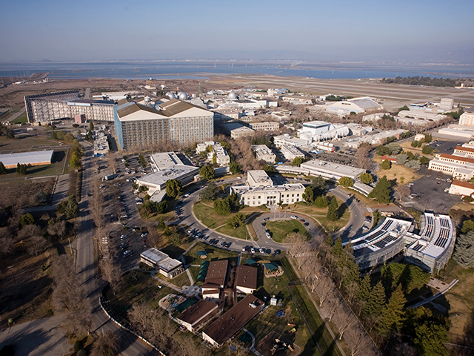
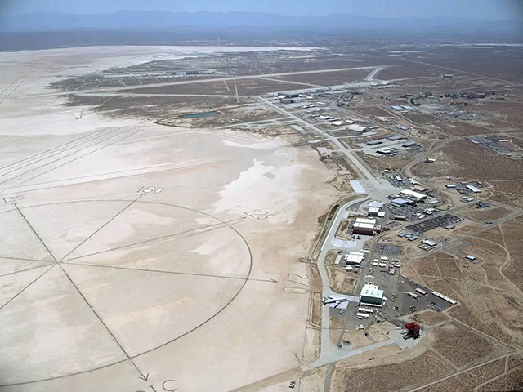
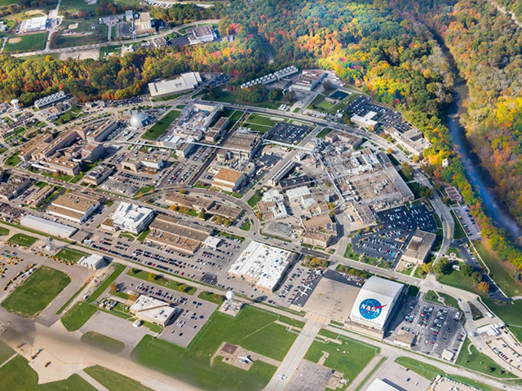
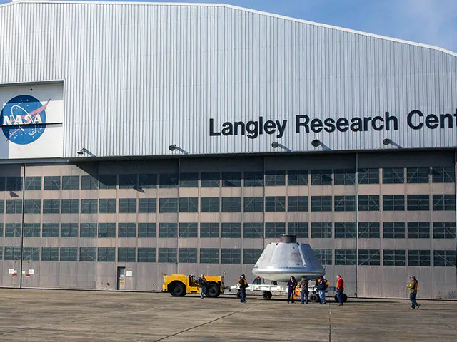
RESEARCH CENTER’S AT A GLANCE
AMES RESEARCH CENTER
NASA’s Ames Research Center, one of ten NASA field centers, is located in the heart of California’s Silicon Valley. Since 1939, Ames has led NASA in conducting world-class research and development in aeronautics, exploration technology and science aligned with the center’s core capabilities.
ARMSTRONG FLIGHT RESEARCH CENTER
NASA’s primary center for high-risk, atmospheric flight research and test projects, with access to 301,000 acres of remote land, year-round flying weather, and the Bell X-1 Supersonic Corridor.
GLENN RESEARCH CENTER AND NEIL A. ARMSTRONG TEST FACILITY
Located near Cleveland Hopkins International Airport, Glenn's main campus, Lewis Field, has world-class facilities including wind tunnels, drop towers, vacuum chambers, and a research aircraft hangar.
LANGLEY RESEARCH CENTER
NASA’s Langley Research Center is revolutionizing aviation, expanding our understanding of the Earth’s atmosphere, and developing innovative technology for space exploration.
Langley plays a critical role across all aspects of the NASA’s missions, from concept to splashdown.

Slide 3
RESEARCH CENTER - CAPABILITIES
AMES RESEARCH CENTER
Air Traffic Management
Entry Systems
Advanced Computing
Intelligent/Adaptive Systems
Small Spacecraft Technology and Missions
Astrobiology and Life Science
Space and Earth Sciences
ARMSTRONG FLIGHT RESEARCH CENTER
Spacecraft/Aircraft Loads, Instrumentation and Systems Integration
Thermal and Ground Testing
Thermal Analysis and Systems Development
Flight Testing of Unique Research Vehicles and Space Systems
Enable Low-cost Access on Commercial Suborbital Space Platforms
Global Atmospheric Research
GLENN RESEARCH CENTER
Air-Breathing Propulsion
Electric Propulsion
Power Systems
Communications
Materials
Physical Sciences
Major Test Facilities including Aero-Propulsion Wind Tunnels and Engine Test Cells
R&D Labs including the World’s Largest Vacuum Facility
LANGLEY RESEARCH CENTER
Entry, Descent and Landing
Aerosciences
Atmospheric Characterization
Systems Analysis and Concepts
Advanced Materials and Structural Systems
Intelligent Flight Systems

Slide 4
TARGETED NAICS
AMES RESEARCH CENTER
541513 | Computer Facilities Management Services
541715 | Research and Development in the Physical, Engineering, and Life Sciences (Except Biotechnology)
561210 | Facilities Support Services
541512 | Computer Systems Design Services
541330 | Engineering Services
541519 | Other Computer Related Services
561612 | Security Guard and Patrol Services

Slide 5
TARGETED NAICS:
ARMSTRONG FLIGHT RESEARCH CENTER
541715 | Research and Development in the Physical, Engineering, and Life Sciences (Except Biotechnology)
561210 | Facilities Support Services
336411 | Aircraft Manufacturing
488190 | Other Support Activities for Air Transportation
336413 | Other Aircraft Parts & Auxiliary Equipment Manufacturing
541519 | Other Computer Related Services
541513 | Computer Facilities Management Services
541690 | Other Scientific & Technical Consulting Services
541310 | Architectural Services

Slide 6
TARGETED NAICS:
GLENN RESEARCH CENTER
541712 | Research and Development in the Physical, Engineering, and Life Sciences (Except Biotechnology)
561210 | Facilities Support Services
541519 | Other Computer Related Services
236220 | Commercial and Institutional Building Construction
541330 | Engineering Services
541690 | Other Scientific and Technical Consulting Services
561612 | Security Guards and Patrol Services
221122 | Electric Power Distribution
611430 | Professional and Management Development Training
611710 | Educational Support Services

Slide 7
TARGETED NAICS
LANGLEY RESEARCH CENTER
541715 | Research and Development in the Physical, Engineering, and Life Sciences (except Nanotechnology and Biotechnology)
561210 | Facilities Support Services
541611 | Administrative Management and General Management Consulting Services
221118 | Other Electric Power Generation
541330 | Engineering Services
541690 | Other Scientific and Technical Consulting Services
336413 | Other Aircraft Parts and Auxiliary Equipment Manufacturing
488190 | Other Support Activities for Air Transportation
332999 | All Other Miscellaneous Fabricated Metal Product Manufacturing

Slide 8
Research Center Top Primes
Contractor | Obligations
MAXAR SPACE LLC | $16,000,000
SCALED COMPOSITES, LLC | $5,831,486
DYNETICS, INC. | $4,796,664
JACOBS TECHNOLOGY INC. | $2,322,909
NORTHROP GRUMMAN SYSTEMS CORPORATION | $2,040,845
REGENTS OF THE UNIVERSITY OF MICHIGAN | $1,700,000
AIRBORNE SYSTEMS NORTH AMERICA OF CA INC. | $1,550,000
AMENTUM SERVICES, INC. | $1,333,551
MILLENNIUM ENGINEERING AND INTEGRATION SERVICES, LLC | $1,310,735
BOOZ ALLEN HAMILTON INC | $1,176,174

Slide 9
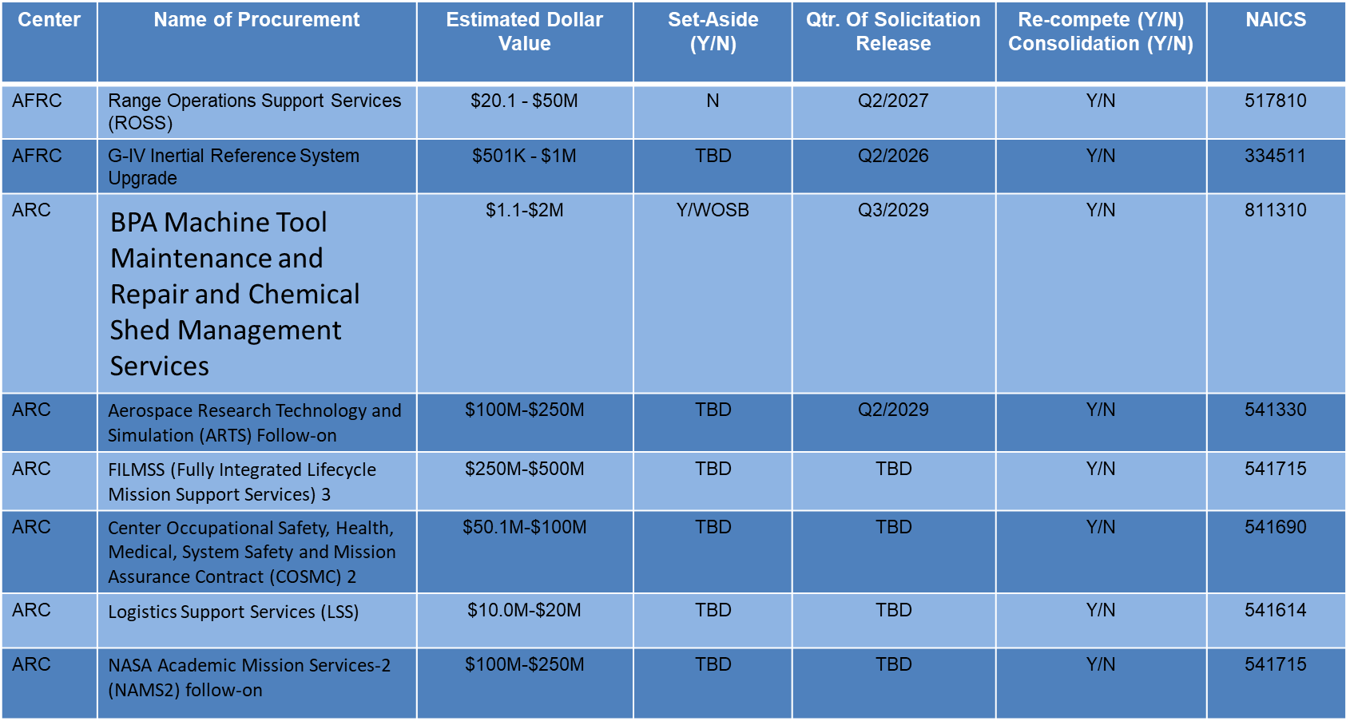
Upcoming Research Center Opportunities

Slide 10
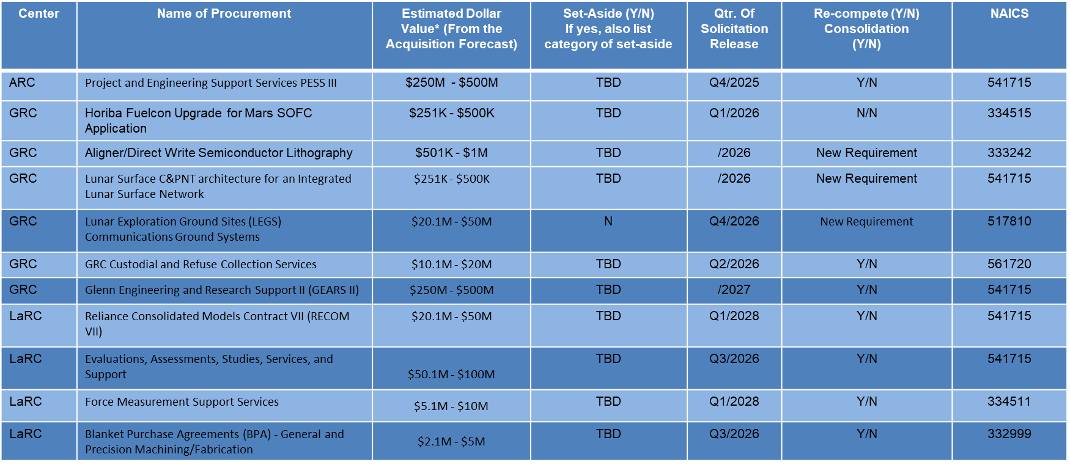
Upcoming Research Center Opportunities

Slide 11
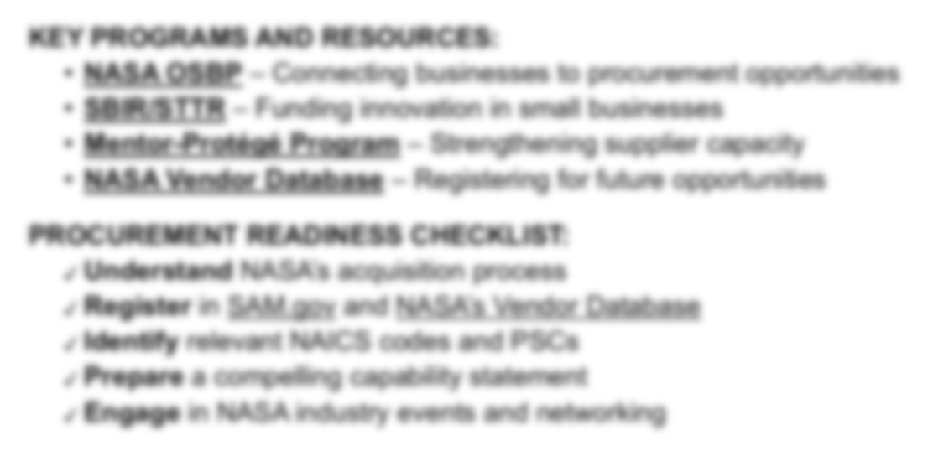



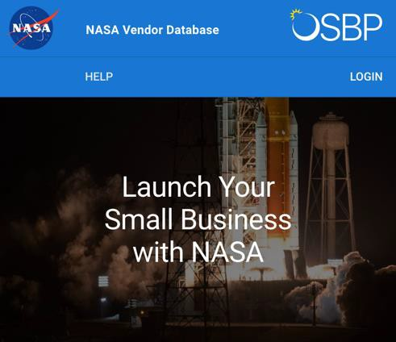
How Small Business Can Engage with NASA
KEY PROGRAMS AND RESOURCES:
NASA OSBP – Connecting businesses to procurement opportunities
SBIR/STTR – Funding innovation in small businesses
Mentor-Protégé Program – Strengthening supplier capacity
NASA Vendor Database – Registering for future opportunities
PROCUREMENT READINESS CHECKLIST:
Understand NASA’s acquisition process
Register in SAM.gov and NASA’s Vendor Database
Identify relevant NAICS codes and PSCs
Review Acquisition Forecast for Requirements
Prepare a compelling capability statement
Engage in NASA industry events and networking
Notes:
Identify Your Product or Service
Identify Your Target Market Within NASA
Participate in NASA OSBP Monthly Learning Series
Familiarize Yourself with NASA Contracting Procedures – GET TO KNOW THE FAR!!
Utilize your local APEX
Explore Subcontracting Opportunities
Tailor your capability statement to the exact requirement
Network with other Small Businesses
Continue to build and establish relationships with NASA stakeholders after winning a contract

Slide 12
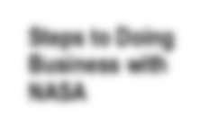
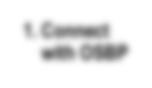
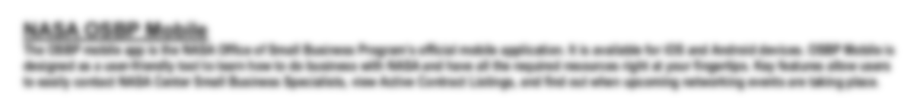




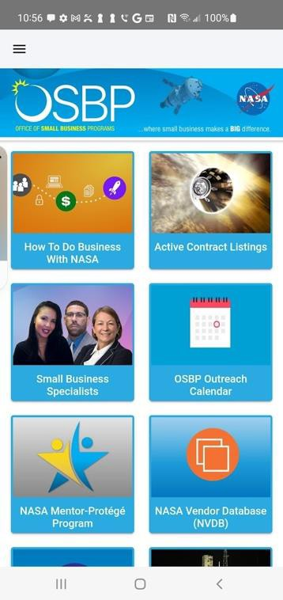
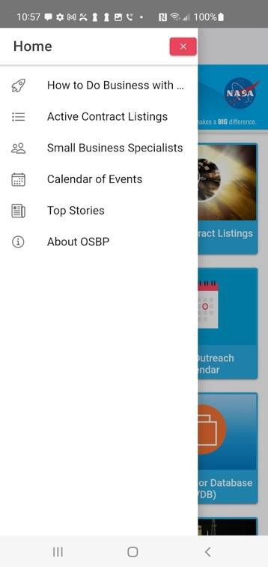
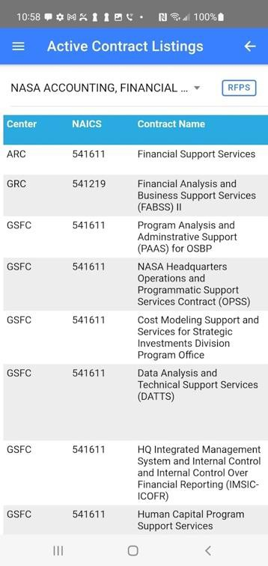
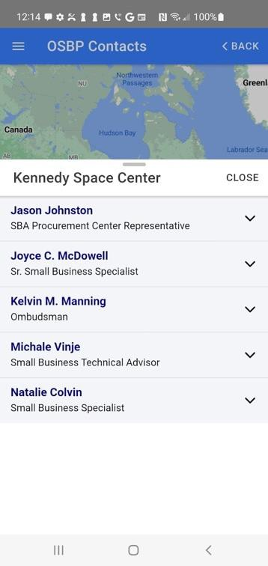
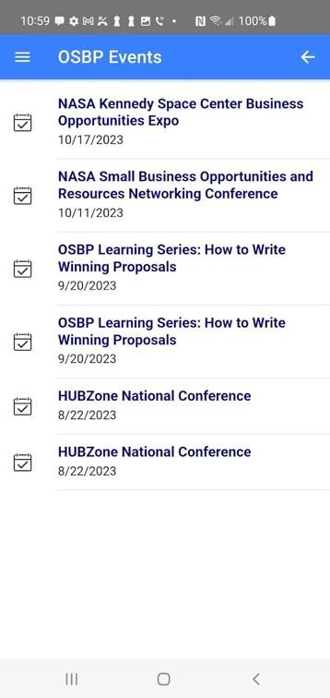
NASA OSBP Mobile App
Steps to Doing Business with NASA
1. Connect with OSBP
NASA OSBP Mobile
The OSBP mobile app is the NASA Office of Small Business Program’s official mobile application. It is available for iOS and Android devices. OSBP Mobile is designed as a user-friendly tool to learn how to do business with NASA and have all the required resources right at your fingertips. Key features allow users to easily contact NASA Center Small Business Specialists, view Active Contract Listings, and find out when upcoming networking events are taking place.
The OSBP mobile app is available for download
at the
iTunes App Store or
Google Play.

Slide 13
ACTIVE CONTRACT LISTING
Recurring contracts Long-term planning purposes
https://www.nasa.gov/osbp/active-contract-listings
  Accounting/Financial/Business Services
  Administrative Services
  Environmental Services and Remediation
  Facilities Maintenance
  IT
  Multiple Award Construction
  Occupational Health
  Protective Services
Upcoming
October 15, 2025
The Year In Review: Annual Small Business Town Hall with NASA OSBP Assistant Administrator

Slide 14
RESEARCH CENTER SUPPORT COUNCILS
**Ames Contractor Council Information: ARC Contractor Council Meets 1st Wednesday (POC: kari.gonter@metis-tech.com ) Website http://amescontractorcouncil.org/
NASA Research Park http://www.nasa.gov/centers/ames/researchpark/home/#.VvMOA0bJSFg
Moffett Airfield Google https://sites.google.com/a/pv-nuq.com/nuq/
**Armstrong Contractor Council Information:
Meets 4th Thursday (POC: Diana Hinton, diana.c.hinton@nasa.gov)
Website: https://www.nasa.gov/centers/armstrong/employment/contractor-opportunities/index.html
Armstrong Virtual Tours: Armstrong Virtual Tours | NASA
**Glenn Contractor Council Information: (Working to Reestablish)
**Langley Steering Council Information: https://www.larccsc.com/
Virtual Tour: https://virtualtour.larc.nasa.gov
NASA LaRC SB Marketing Guide: https://www.nasa.gov/osbp/about-nasa-centers/#langley
Website: www.nasa.gov/osbp

Slide 15




@NASA_OSBP
OSBP Gets Social! Follow Us!!
Check out NASA’s LinkedIn page for OSBP updates!

Slide 16
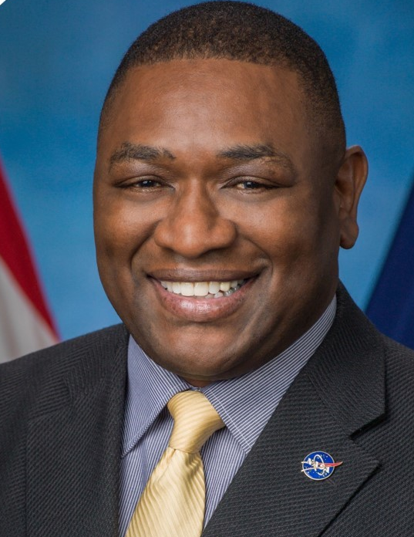

Contact Information
Robert E. Watts Sr. Djaataa Onanuga
Lead Business
Development Specialist
Business
Development Specialist
Contact Research Center OSBP:
Hq-rc-smallbusiness@mail.nasa.gov

Slide 17
Questions and Answers Session

